Slide 1
FunGamesInc. Presents: Connect Four (With Networking)
By: Vishwa Kode
Joseph Thomas
Anshuman Dikhit

Slide 2
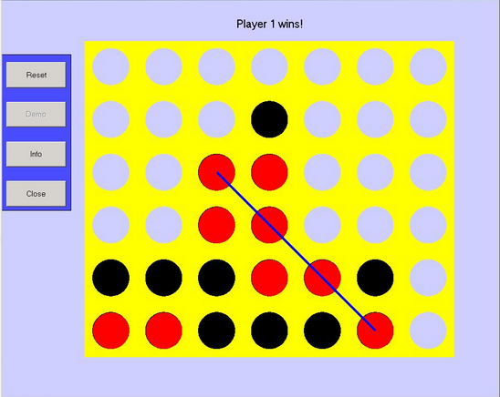
What is Connect Four?
Classic Two Player Strategy Game Created By Howard Wesler
Drop Chips into Grid
First to four consecutive chips wins
Played on 6x7 Grid
Rules:
Player 1 goes first
Alternate dropping pieces
First to four consecutive chips wins

Slide 3
What’s Different?
Our Connect Four played on Grid World Interface
Has Easy, Medium, Hard AI Options
Can Play With Friends Online Using Networked Connect Four (failed)

Slide 4
Responsibilities
Vishwa Kode (Project Lead) | Joseph Thomas | Anshuman Dikhit
-Classes: -Piece -PieceDisplay -ConnectPlayer -Prioritize -Connect Runner -Documentation -Specifications -JUnit Testing -Project Write Up and Power Point Presentation | -Classes: - EasyAI -MediumAI -HardAI -ConnectWorld -Documentation -Specifications -Junit Testing -Final Project Write Up | -Classes: -Board -Networking -PowerPoint -Final Project Write Up

Slide 5
Hard AI Implementation
Uses Prioritize to rate different locations on the board
Rates by looking at chains of chips
Picks locations with the longest chain of chips
Makes sure to block opponent

Slide 6
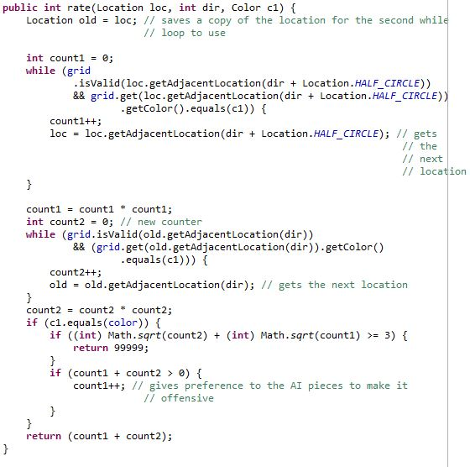

Slide 7
Medium AI Implementation
Works the same as Hard AI except a little differently
Doesn’t always make the move with the best rating

Slide 8
Easy AI Implementation
Checks the list of allowed moves
Randomly makes a move

Slide 9
Human Player Implementation
Checks where the user clicks
Places the piece in the lowest part of the column

Slide 10
Non-Hierarchical Classes
Game
Board
Runner

Slide 11
Game Implementation
Runs the game until it detects a win
Sets game up based on selected difficulty
Outputs messages at the top of gridworld

Slide 12
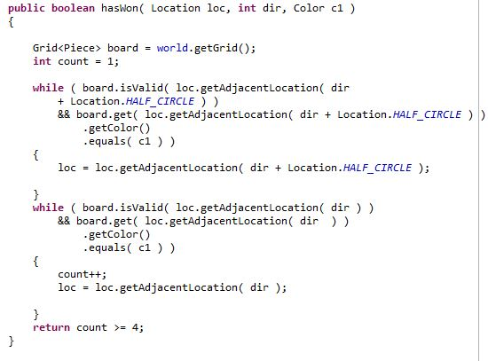
ConnectGame Code

Slide 13
Runner Implementation
Asks the user to input difficulty or to quit
Runs game till it has been won or ended in a tie

Slide 14
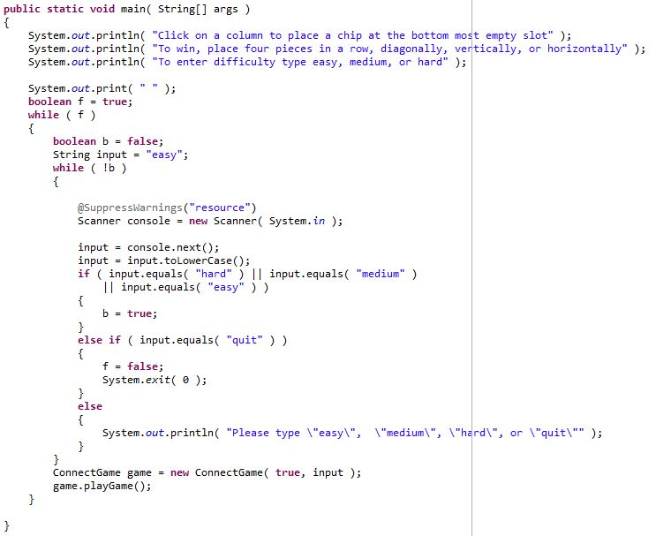

Slide 15
What Is Networking?
Networking is the practice of linking two or more computing devices with the purpose of sharing data.
Requires a server and clients
Clients connect and share data through server

Slide 16
How We (Tried to) Implement Networking
We tried to create a main Game Server, which would either connect a Human Player client and an Artificial Intelligence client, or two Human Players.
Each Artificial Intelligence Client connected to the main Game Server, which started a game session with the human client
For human to human, we tried to connect two human players to the main game server, and we were actually successful, but there were problems in the communication of the different moves
e.g. sometimes the game boards did not update the opponent’s moves

Slide 17
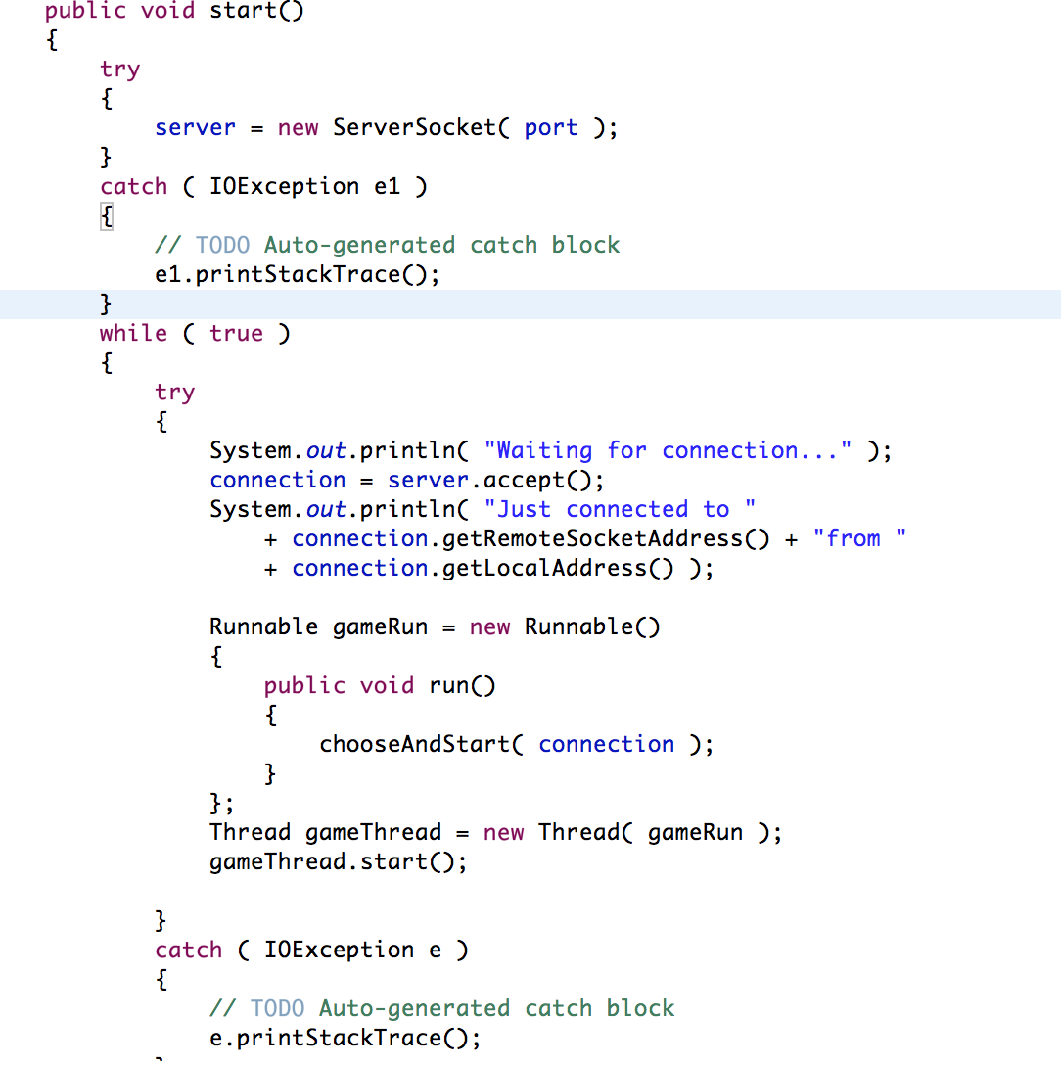
Networking Code
The method that set up the connection
between clients.

Slide 18
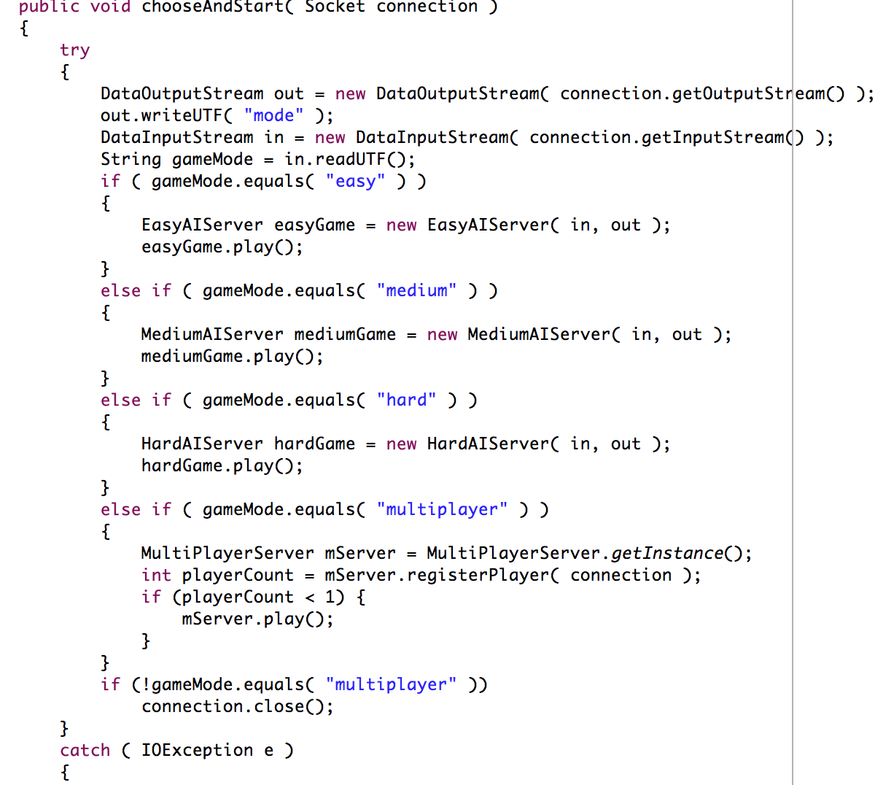
Networking Code
Networking code that would
allow human client to choose
whether they wanted to play
an easy, medium, or hard AI
or whether it wanted to go
multiplayer. Notice how each
AI and multiplayer has
its own server.

Slide 19
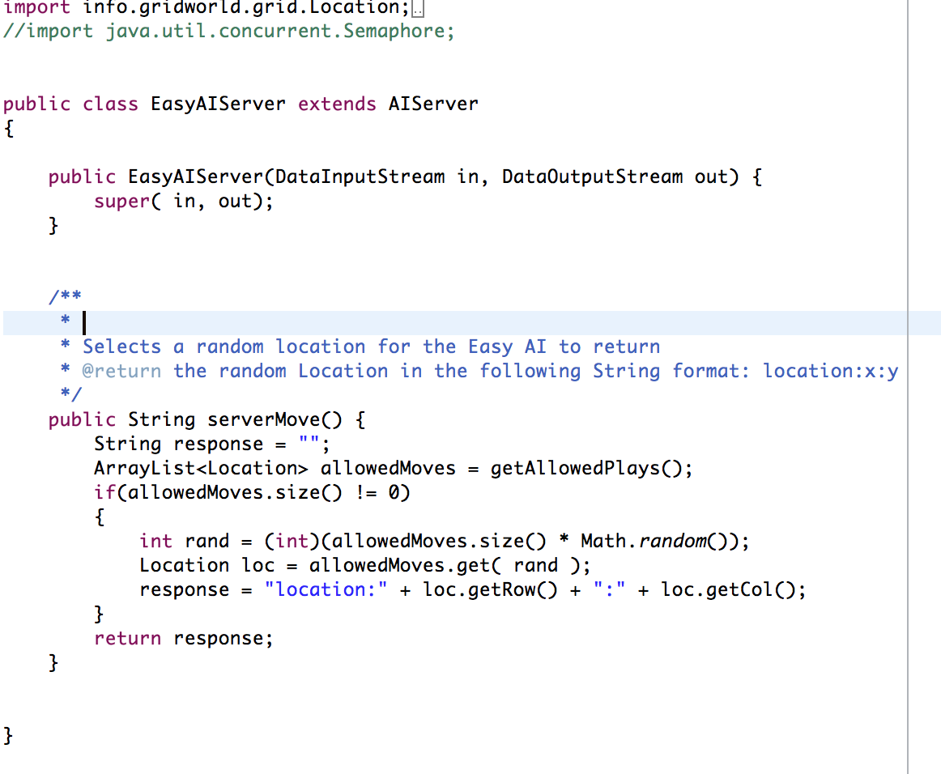
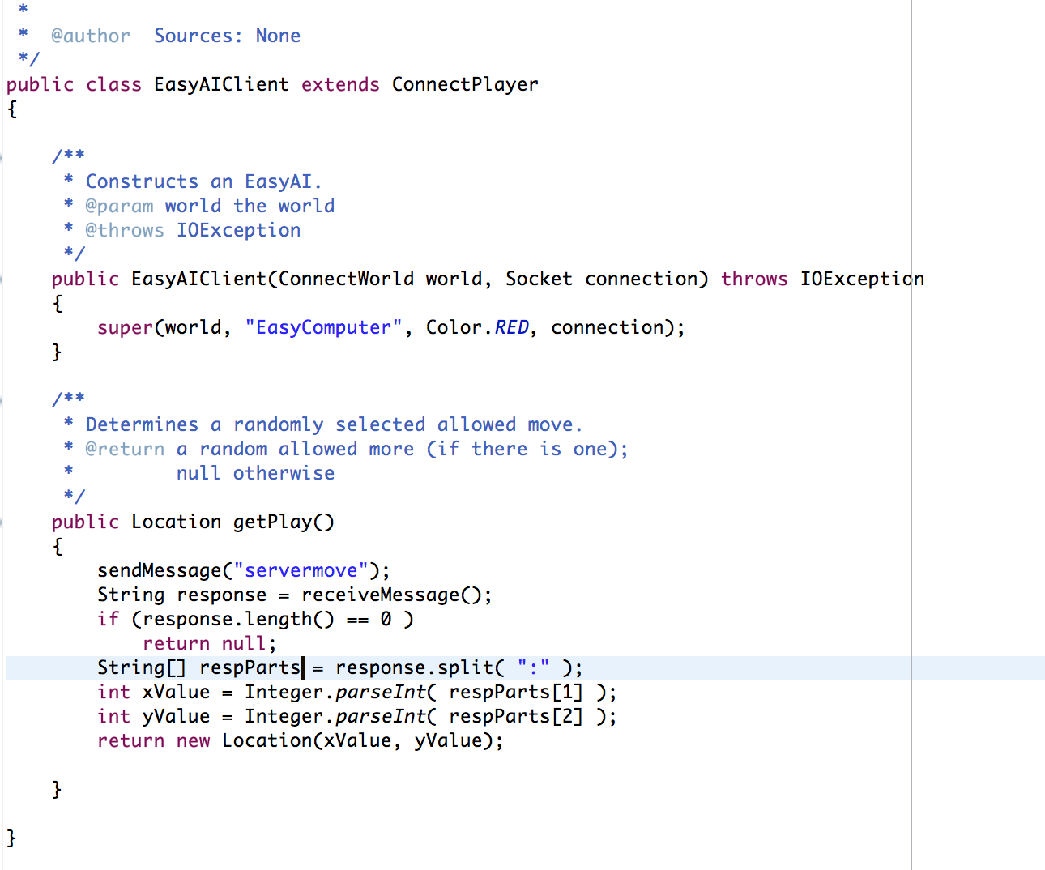
EasyAI Server and Client

Slide 20
Developmental Timeline
Week 1
Chose Connect Four As Our Game
Decided Plans, Responsibilities and Timeline
Week 2
Made the GUI
Implemented Easy, Medium, Hard AI Logic and Code
Week 3
Integrated the AI Code into the Connect Four Game
Week 4
Week 5
Finished Junit Testing
Debugged AI and GUI Code
Completed Presentation and Final Specifications
Attempt at Integrating Networking

Slide 21
Technical Requirements
Eclipse Java Development Toolkit Installed
Java Development Kit 6.0 or Higher Installed
1GB of RAM or more

Slide 22
Installation Instructions Against AI
Import Connect4 File Into Eclipse
Open Connect4 Project
Hit Play button (Green Button With Arrow)
Enter Level of Difficulty
Enjoy the Game

Slide 23
Why Our Connect Four Game?
Improve Critical Thinking and Strategy
Develop Skill Level at Connect Four
Classic Game for all ages
Very Fun Game to play when Bored
Can Play with anyone in the world

Slide 24
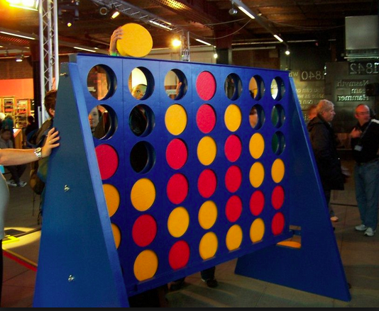
Thanks For Listening

